Slide 1
The Stray Loss EvaluatIon and
ShIeldIng In Structural
Parts of Power Transformers
Selim Yurekten, Turkey
2019 CIGRE SC-A2, B2 & D1 INDIA COLLOQUIUM
s.yurekten@enpay.com

Slide 2
Summary
Introduction
1. Tank walls
2. Yoke Clamping Structures
3. The other parts
3.A. Flitch Plates (Tie Bars)
3.B. Core edge Stacks
3.C. Bus Bars/Bushing Mounting Plates
Conclusion
2019 CIGRE SC-A2, B2 & D1 INDIA COLLOQUIUM

Slide 3
SUMMARY
We will be focus on the stray losses ‘’nonlinear eddy current losses, according to Faraday Law and Lenz Law’’ and shielding in structural parts in power transformers.
The shielding calculation/ simulation and design are important ,especially in larger power transformers.
The stray load losses are mainly in copper parts ‘’windings, leads and connecting conductors’’ roughly 50%, and in structural parts ‘’tanks, yoke clamping structures, flitch plates /tie bars, core edges’’ the other half.
Due to stray losses ,over heating in small areas, if not properly cooled.
Effects of different manufacturing processes.
2019 CIGRE SC-A2, B2 & D1 INDIA COLLOQUIUM

Slide 4
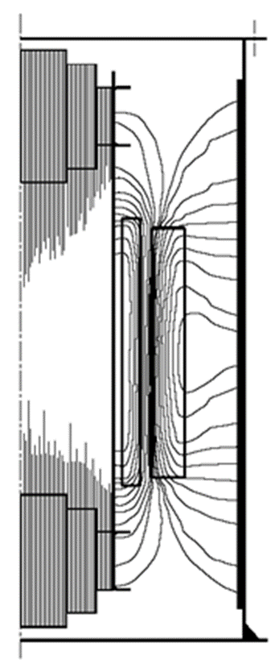
INTRODUCTION
Stray loss is a component of load loss
Structural parts are generally low carbon steel with high magnetic, high electrical conductivity, and large thickness 7-15 mm.
Penetration depth ‘’skin effect’’ of magnetic field is much thinner
The result : Higher eddy currents and occurring of the stray losses
Major part of stray losses are in the tank, core clamping plates, smaller are in flitch plates/tie-bars ,edge stacks, high current bars.
If the flux density becomes too high, excessive temperature rise always the result with problem
2019 CIGRE SC-A2, B2 & D1 INDIA COLLOQUIUM

Slide 5
1. TANK WALLS
The stray load losses in power transformers are in copper parts (windings, leads, connecting Conductors) approx.50 % and in the structural parts (tanks, yokes, clamping structures, flitch plates, core edges) other approx. 50%.
The stray flux departing radially from outer windings, gives rise to eddy current losses and hot-spots in the tank, in the yokes clamping parts and all the other structural parts. Hot-spots cause overheating. There are various ways to control and minimize stray losses.
Roughly calculation of eddy current loss
P=K B² f ²t²
K= constant , B= magnetic induction, f= frequency, t= material thick.
2019 CIGRE SC-A2, B2 & D1 INDIA COLLOQUIUM

Slide 6
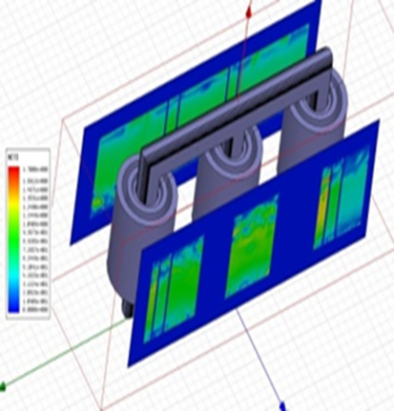
1. TANK WALLS
For the accurate result of nonlinear eddy current analysis; 3-D FEM simulation with advanced analysis tools must be used.
Results:
Better optimization of the shunts and design of them
Estimation and reduction of stray losses
In shorter time
2019 CIGRE SC-A2, B2 & D1 INDIA COLLOQUIUM

Slide 7
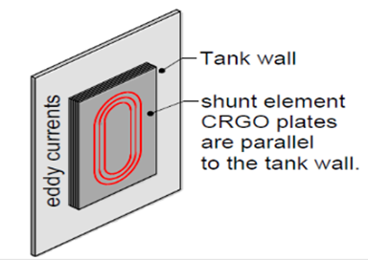
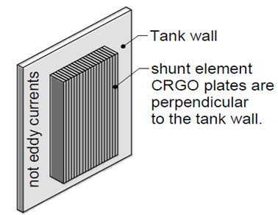
1. TANK WALLS
In practice there are two types of magnetic shunt elements from CRGO used.
Wide band shunts placed parallel on the tank wall, they have stray losses more and some other disadvantages to compare with edge-wise type.
The edge- wise shunts have less stray losses, more advantage.
2019 CIGRE SC-A2, B2 & D1 INDIA COLLOQUIUM

Slide 8
1. TANK WALLS
One result of the with analytical calculated stray losses in the tank walls:
Main data of the power transformer : 500 MVA, 400 kV,60 Hz, 3/0
Stray loss in tank walls without shunt : 138,48 kW
Stray loss in tank walls with shunt : 61,11 kW
The advantage : 77,37 kW
Main data of Auto Transformer : 125 MVA 230/121/10,5 kV.
Stray loss in tank walls without shunt : 51, 8 kW
Stray loss in tank walls with shunt : 6,9 kW
The advantage : 44,9 kW
The capitalized expenses the shielding's are beneficial. Because their cost are greatly lower than capitalized load losses cost.
2019 CIGRE SC-A2, B2 & D1 INDIA COLLOQUIUM

Slide 9
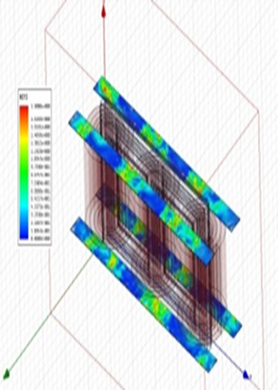
2. YOKE CLAMPING STRUCTURES
Yoke clamping structures are made of mild steel mostly and used for clamping of yokes and supporting the windings.
Stray losses occur mostly after tank walls in yoke clamping structure.
Loss simulation and calculation can be used 2D or better 3D FEM.
Up to mid side of power transformers yoke clamping plates can be use laminated board or densified electrical grade laminated wood. Reducing of stray losses and heating effects.
2019 CIGRE SC-A2, B2 & D1 INDIA COLLOQUIUM

Slide 10
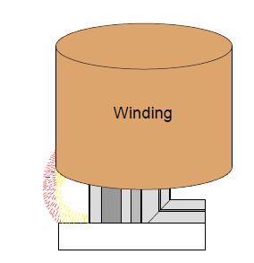
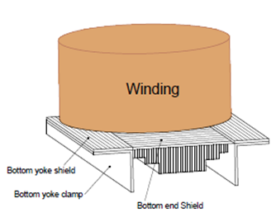
2. YOKE CLAMPING STRUCTURES
The bottom end shields and clamps are in similar shape like yoke clamps and used mostly in bottom side, oriented so that flux is directed back into the core.
Using in big powers- and autotransformers
2019 CIGRE SC-A2, B2 & D1 INDIA COLLOQUIUM

Slide 11
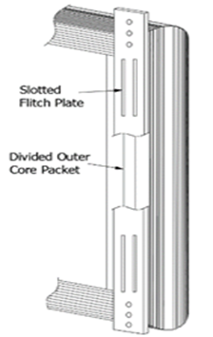
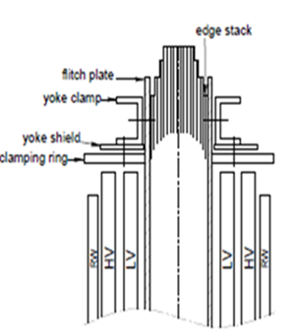
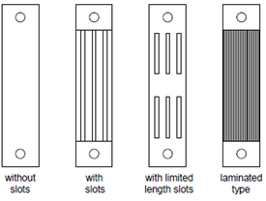
3.A. FLITCH PLATES (TIE BARS)
Flitch plates ‘’tie bars’’ used to hold and compress core and for lifting of them.
The stray losses are approx.5-8% of total stray losses.
3-D FEM simulation is a accurate method for calculation.
There are 4 different types, depend of the stray losses power.
Without slots, with limited slots, with full slots, laminated type.
Laminated type is particularly for higher rating and generator transformers
2019 CIGRE SC-A2, B2 & D1 INDIA COLLOQUIUM

Slide 12
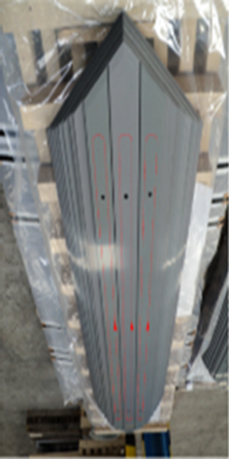
3.B. CORE EDGE STACK
The stray losses in core edge stack occur due to flux influence on core lamination
The out side of laminations are subjected to this condition
Stray flux come perpendicular in legs and induces big eddy currents.
First core step is usually split in two or three parts
Big losses in core parts with large widths.
For simulation, 3-D FEM can have accurate result.
2019 CIGRE SC-A2, B2 & D1 INDIA COLLOQUIUM

Slide 13
3.C.BUSHING MOUNTING PLATES / BUS-BARS
High current losses can cause high stray losses and temperature rises. In higher than approx.2500 Amps. bus bar are used.
In order to eliminate hot spots, bus-bar mounting plates with non- magnetic stainless steel are inserted or made of full stainless steel plates.
Particularly currents in low voltage side of large generator step-up transformers and in tertiary windings of auto transformers can be extremely high.
To optimize field effect 3-phase connection ,leads of all 3-phases can be grouped together.
2019 CIGRE SC-A2, B2 & D1 INDIA COLLOQUIUM

Slide 14
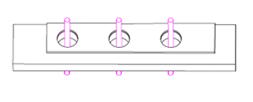
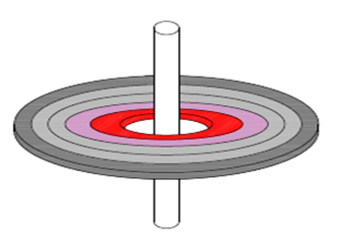
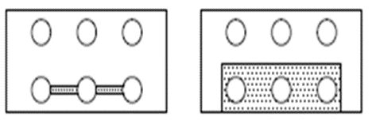
3.C.BUSHING MOUNTING PLATES / BUS-BARS
2019 CIGRE SC-A2, B2 & D1 INDIA COLLOQUIUM

Slide 15
CONCLUSION
We have studied the eddy currents and stray losses in the structural parts, and magnetic shielding of power transformers.
Big part of stray losses are in the tanks, in yoke clamping structures, and smaller in flitch plates, in core limb edge stacks.
The better shielding materials and design for tank and yoke shielding are the CRGO magnetic ribbons , as edge-wise shunts.
To study and calculation all of that places can be use various methods. The more successful one is the Finite element method FEM 3-D, some time can be enough also 2-D.
Accurate stray loss calculations are also required to meet guaranteed losses and to determine possible hot-spots in structural components.
2019 CIGRE SC-A2, B2 & D1 INDIA COLLOQUIUM

